Slide 1
Object Oriented Programming (JAVA – Part 5)
Inheritance in Java
B.Tech DSE
III C

Slide 2
Inheritance in Java
Inheritance in Java is a mechanism where one class acquires the properties (fields) and behaviours (methods) of another class.
It is one of the four fundamental concepts of Object-Oriented Programming (OOP) in Java, along with encapsulation, polymorphism, and abstraction.
Key Terms in Java Inheritance:
Superclass (Parent Class / Base Class): The class whose properties are inherited by another class.
Subclass (Child Class / Derived Class): The class that inherits properties and methods from the superclass.
extends keyword: This keyword is used by a subclass to inherit from a superclass.

Slide 3
Extending Classes
In Java, extending classes refers to creating a subclass that inherits from a superclass using the extends keyword.
This allows the subclass to inherit fields and methods from the superclass, enabling code reuse and promoting a hierarchical relationship between classes.
In Java, a class can extend only one superclass due to the single inheritance model.
When a subclass is instantiated, the constructor of the superclass is called first.

Slide 4
Extending Classes continued………………
Subclass
A subclass is a specialized version of a superclass.
It inherits all the instance variables and methods defined by the superclass and add its own unique elements.
We can specify only one superclass for any subclass as Java does not support multiple inheritance.
The general form is:
class subclassname extends superclassname
{
body of class
}

Slide 5
Example 1
class A
{
int i,j;
void show1() {
System.out.println(" The values of i and j:"+i+" "+j);
} }
class B extends A
{
int k;
void show2() {
System.out.println(" The values of k:"+k); }
void sum() {
System.out.println(" The sum of i+j+k is:"+(i+j+k));
} }

Slide 6
Example continues…………..
class inh {
public static void main(String[] args)
{
A aobj= new A();
B bobj= new B();
aobj.i=10;
aobj.j=20;
aobj.show1();
bobj.i=7;
bobj.j=8;
bobj.k=9;
bobj.show1();
bobj.show2();
bobj.sum();
} }

Slide 7
Output
The values of i and j:10 20
The values of i and j:7 8
The values of k:9
The sum of i+j+k is:24

Slide 8
Types of Inheritance in Java
Single Inheritance: A subclass inherits from only one superclass.
Multilevel Inheritance: A class inherits from a class that is also a subclass of another class.
Hierarchical Inheritance: Multiple subclasses inherit from a single superclass.
Java does not support multiple inheritance (i.e., a class cannot inherit from more than one class directly) to avoid complexity and ambiguity.
However, this can be achieved using interfaces.

Slide 9
Single Inheritance
Single Inheritance is a subclass inherits from only one superclass.
Example 1 is an example of Single Inheritance

Slide 10
Multilevel Inheritance
Multilevel inheritance in Java refers to a scenario where a class inherits from another class, and then that class is further inherited by another class, forming a chain of inheritance across multiple levels.
In multilevel inheritance:
The first class (top-level) is the superclass for the second class.
The second class is both a subclass (of the first class) and a superclass (for the third class).
The third class is the subclass of the second class.
Key Characteristics
The subclass at each level inherits all the properties and behaviours (methods and fields) of its parent class.
The chain of inheritance can extend through multiple levels.

Slide 11
Example 2
// Top-level Superclass: Animal
class Animal {
void eat() {
System.out.println("This animal eats food.");
}
}
// Intermediate Class: Mammal (inherits from Animal)
class Mammal extends Animal {
void breathe() {
System.out.println("This mammal breathes air.");
}
}

Slide 12
Example 2 continued…………….
// Subclass: Dog (inherits from Mammal)
class Dog extends Mammal {
void bark() {
System.out.println("The dog barks.");
}
}
class Main {
public static void main(String[] args) {
// Create an object of the Dog class
Dog myDog = new Dog();
// Calling methods from all levels of the inheritance chain
myDog.eat(); // Inherited from Animal
myDog.breathe(); // Inherited from Mammal
myDog.bark(); // Defined in Dog
} }

Slide 13
Output
This animal eats food.
This mammal breathes air.
The dog barks.

Slide 14
Hierarchical Inheritance
Hierarchical inheritance in Java occurs when multiple classes inherit from the same superclass.
In this type of inheritance, a single parent class is extended by two or more child classes.
Each subclass inherits properties and behaviours from the common superclass but can have its own unique features as well.
Key Characteristics
Single Parent Class: Multiple child classes share the same parent class.
Multiple Inheritance Paths: Each child class independently inherits from the parent class.
Common Features: The child classes inherit common properties and behaviours from the parent class but can also add their own specific features.

Slide 15
Example 3
// Superclass: Animal
class Animal {
void eat() {
System.out.println("This animal eats food.");
}
void sleep() {
System.out.println("This animal sleeps.");
} }
// Subclass 1: Dog (inherits from Animal)
class Dog extends Animal {
void bark() {
System.out.println("The dog barks.");
} }

Slide 16
Example 3 continues…………
// Subclass 2: Cat (inherits from Animal)
class Cat extends Animal {
void meow() {
System.out.println("The cat meows.");
} }
class Main {
public static void main(String[] args) {
// Create an object of the Dog class
Dog myDog = new Dog();
myDog.eat(); // Inherited from Animal
myDog.sleep(); // Inherited from Animal
myDog.bark(); // Defined in Dog
// Create an object of the Cat class
Cat myCat = new Cat();
myCat.eat(); // Inherited from Animal
myCat.sleep(); // Inherited from Animal
myCat.meow(); // Defined in Cat
} }

Slide 17
Output
This animal eats food.
This animal sleeps.
The dog barks.
This animal eats food.
This animal sleeps.
The cat meows.

Slide 18
The Super Keyword
This is used to call the superclass’s constructor or methods.
Super may only be used within a subclass constructor method.
The call to superclass constructor must appear as the first statement within the subclass constructor.
The parameters in the super call must match the order and type of the instance variable declared in the superclass
Constructor Chaining:
When a subclass is instantiated, the constructor of the superclass is called first.
If the superclass constructor requires arguments, they must be passed using super(arguments) in the subclass constructor.
The Parent constructor is called before the Child constructor

Slide 19
Example of Constructor Chaining:
class Parent {
Parent() {
System.out.println("Parent class constructor");
}
}
class Child extends Parent {
Child() {
super(); // Optional: Java adds this by default if no args are passed
System.out.println("Child class constructor");
}
}
public class Main {
public static void main(String[] args) {
Child child = new Child();
}
}

Slide 20
Output
Parent class constructor
Child class constructor

Slide 21
Runtime Polymorphism
Runtime polymorphism, also known as dynamic polymorphism or late binding.
It is a concept in object-oriented programming where the method that gets executed is determined at runtime, rather than at compile time.
This is typically achieved with method overriding in inheritance and relies on a technique called dynamic method dispatch.
Method Overriding: The subclass provides its own implementation of a method that is already defined in the superclass.
Dynamic Method Dispatch: At runtime, the actual type of the object is determined, and the appropriate overridden method is called, even if the object is referred to by a reference of the superclass. It allows a method to perform different tasks based on the object that invokes it, even though the method call is the same.

Slide 22
Method Overriding in Java
When a method in a subclass has the same name and type as a method in its superclass, then the method in the subclass is said to override the method in the superclass.
If subclass (child class) has the same method as declared in the parent class, it is known as method overriding in Java.
Method overriding is used for runtime polymorphism
Method overriding is a key concept of run-time polymorphism, meaning the method to be called is determined at runtime based on the object type.
Method overriding occurs only when the names, types and number of arguments of the two methods are identical. Otherwise, the two methods are simply overloaded.

Slide 23
Rules for Java Method Overriding
The method must have the same name as in the parent class
The method must have the same parameter and type as in the parent class.
There must be an IS-A relationship (inheritance).

Slide 24
Example 1 of Method Overriding
// Superclass
class Animal {
void sound() {
System.out.println("This animal makes a sound.");
} }
// Subclass 1: Dog
class Dog extends Animal {
@Override
void sound() {
System.out.println("The dog barks.");
} }
// Subclass 2: Cat
class Cat extends Animal {
@Override
void sound() {
System.out.println("The cat meows.");
} }

Slide 25
Continued…………
class inh1 {
public static void main(String[] args) {
Animal aa = new Animal();
// Create objects of the subclasses
Animal myDog = new Dog();
Animal myCat = new Cat();
aa.sound();
// Call the sound method (overridden versions)
myDog.sound(); // Outputs: The dog barks.
myCat.sound(); // Outputs: The cat meows.
}
}

Slide 26
Output
This animal makes a sound.
The dog barks.
The cat meows.

Slide 27
Example Overriding (Second Method)
// Superclass
class Animal {
void sound() {
System.out.println("This animal makes a sound.");
} }
// Subclass 1: Dog
class Dog extends Animal {
@Override
void sound() {
System.out.println("The dog barks.");
} }
// Subclass 2: Cat
class Cat extends Animal {
@Override
void sound() {
System.out.println("The cat meows.");
} }

Slide 28
Continued………..
class inh3 {
public static void main(String[] args) {
Animal a = new Animal();
Dog d = new Dog();
Cat c = new Cat();
Animal r; //r is a reference of type Animal
r=a;
r.sound(); //Calls Superclass method
r=d;
r.sound();//Calls Dog class method
r=c;
r.sound();// Calls Cat class method
}
}

Slide 29
Output
This animal makes a sound.
The dog barks.
The cat meows.

Slide 30
Super Keyword in Method Overriding:
The super keyword is used to call the superclass version of an overridden method.

Slide 31
Example
class Animal {
void sound() {
System.out.println("This animal makes a sound.");
} }
class Dog extends Animal {
@Override
void sound() {
super.sound(); // Calling the superclass method
System.out.println("The dog barks.");
} }
public class Main {
public static void main(String[] args) {
Dog myDog = new Dog();
myDog.sound();
} }

Slide 32
Output
This animal makes a sound.
The dog barks.
Here, the super.sound() call invokes the sound() method from the Animal class, followed by the sound() method from the Dog class.

Slide 33
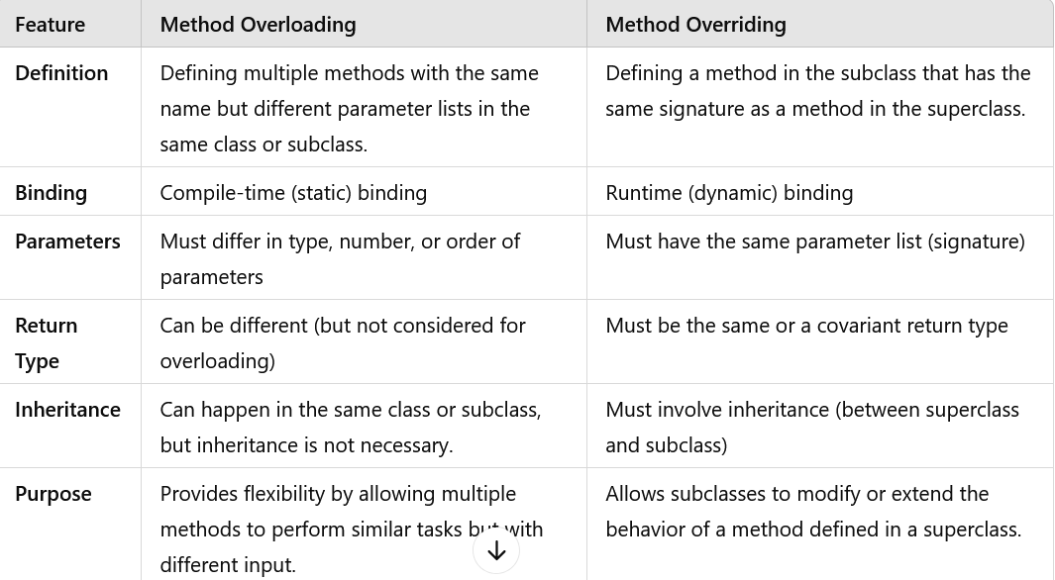


Slide 34
Abstract Classes
In Java, an abstract class is a class that cannot be instantiated directly.
Abstract class: is a restricted class that cannot be used to create objects (to access it, it must be inherited from another class). But it is possible to create a reference variable of abstract class.
Abstract method: can only be used in an abstract class, and it does not have a body. The body (the specific implementations) is provided by the subclass (inherited from).
Abstract class is used to define a common structure for its subclasses, where some methods may be defined and some left abstract (without a body).

Slide 35
Key Points about Abstract Classes:
Cannot be instantiated: You cannot create an object of an abstract class directly. Instead, you need to subclass it and provide implementations for its abstract methods.
Abstract methods: An abstract class can have abstract methods, which are methods declared without a body (implementation). Subclasses of the abstract class are required to provide an implementation for these methods.
Non-abstract methods (Concrete methods): An abstract class can also have non-abstract methods (methods with a body) that can be inherited by its subclasses.
Can have fields and constructors: Abstract classes can define fields and constructors, which can be used by subclasses.
Inheritance: To use an abstract class, another class needs to extend it and provide implementations for the abstract methods. If a subclass does not provide implementations for all abstract methods, it must also be declared as abstract.

Slide 36
continues……………
Abstract class declaration: The keyword abstract is used to declare a class as abstract. For example:
abstract class Animal {
// abstract class definition
}
Abstract method declaration: An abstract method is declared with the keyword abstract and does not include a body. For example:
abstract void sound();
Constructor in abstract class: Abstract classes can have constructors, which can be used when objects of subclasses are created.
Use an abstract class when you want to provide a common base class with shared code and some methods that should be implemented by the derived classes.

Slide 37
Example
// Abstract class
abstract class Animal {
// Abstract method (does not have a body)
abstract void sound();
// Non-abstract method (has a body)
void sleep() {
System.out.println("The animal is sleeping");
} }
// Subclass (inheriting from Animal)
class Dog extends Animal {
// Providing implementation for the abstract method
void sound() {
System.out.println("The dog barks");
} }

Slide 38
Continues…….
// Subclass (inheriting from Animal)
class Cat extends Animal {
// Providing implementation for the abstract method
void sound() {
System.out.println("The cat meows");
} }
class abb {
public static void main(String[] args) {
Animal dog = new Dog();
dog.sound(); // Output: The dog barks
dog.sleep(); // Output: The animal is sleeping
Animal cat = new Cat();
cat.sound(); // Output: The cat meows
cat.sleep(); // Output: The animal is sleeping
} }

Slide 39
Output
The dog barks
The animal is sleeping
The cat meows
The animal is sleeping

Slide 40
Final Classes
In Java, a final class is a class that cannot be extended or subclassed.
Once a class is declared as final, no other class can inherit from it, ensuring that its implementation remains unchanged in any subclass.
A final class is a useful tool for maintaining the integrity and immutability of your code, especially when you want to prevent any alteration or inheritance in a class’s behaviour.
It is especially important in the context of immutable objects and API design.
A final class is declared using the final keyword.
final class MyClass {
// Class contents
}

Slide 41
Key Points about Final Classes
Cannot be inherited: Declaring a class as final prevents any other class from extending it. This ensures that no one can alter or override its behavior through inheritance.
Immutable classes: Final classes are often used when creating immutable classes (classes whose instances cannot be modified after creation). For example, Java’s String class is final, ensuring that its behavior is consistent and secure.
Security and reliability: Marking a class as final can prevent unintended modifications and enhance security, especially in API development where you don’t want users to alter certain behaviors.
Final methods in final classes: Since a final class cannot be extended, all its methods are inherently final. However, you can also declare individual methods as final to prevent them from being overridden, even in non-final classes.

Slide 42
Uses of Final Classes:
Immutable classes: Final classes are often used to create immutable objects (e.g., String, Integer, Boolean). This ensures the class's behaviour remains predictable and unmodifiable.
Security: When designing classes for APIs or sensitive systems, you may want to mark a class as final to prevent others from altering its behavior through inheritance.
Efficiency: In some cases, marking a class as final can allow the JVM to perform certain optimizations, as it knows that the class hierarchy will not change.

Slide 43
Example
final class Vehicle {
void display() {
System.out.println("This is a vehicle");
}
}
// The following class will cause a compile-time error
class Car extends Vehicle { } // Error: Cannot inherit from final class

Slide 44
Final Methods and Overriding:
If a method is marked as final, it cannot be overridden in a subclass.

Slide 45
Example
class Animal {
final void sound() {
System.out.println("This animal makes a sound.");
}
}
class Dog extends Animal {
// Compilation error: cannot override final method from Animal
@Override
void sound() {
System.out.println("The dog barks.");
}
}

Slide 46
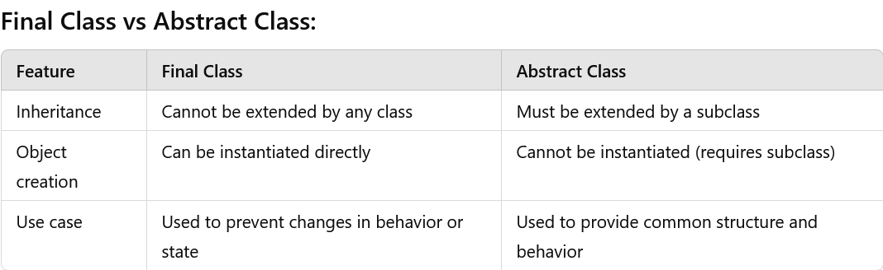

Slide 47
Inner Classes in Java
In Java, inner classes are classes defined within another class.
They provide a logical grouping of classes and can help in better encapsulation, especially when a class is used only in the context of another class.
Inner classes can access the members (including private members) of the outer class, which is an advantage over regular class relationships.

Slide 48
Types of Inner Classes in Java
Static Nested Class
Non-static Inner Class (Regular Inner Class)
Local Inner Class
Anonymous Inner Class (Can be used only with Interface)

Slide 49
Static Nested Class
Definition: A static nested class is a nested class that is declared with the static keyword.
Association with Outer Class: It is associated with the outer class, but not with instances of the outer class. This means it can be instantiated without creating an instance of the outer class.
Access to Outer Class Members: It can access only static members (fields and methods) of the outer class. It cannot access instance (non-static) members directly.
Instantiation: Since it's static, it is instantiated like a static member, using the outer class name.

Slide 50
Continued………..
Characteristics:
Declared with the static keyword.
It can access only the static members of the outer class.
Does not require an instance of the outer class to be instantiated.

Slide 51
Example
class OuterClass {
static int outerVar = 10;
// Static nested class
static class StaticNestedClass {
void display() {
// Can access only static members of the outer class
System.out.println("Outer static variable: " + outerVar);
} } }
public class Main {
public static void main(String[] args) {
// Creating an instance of the static nested class
OuterClass.StaticNestedClass nested = new OuterClass.StaticNestedClass();
nested.display();
} }

Slide 52
Non-static Inner Class (Regular Inner Class)
Definition: A non-static inner class (also called a regular inner class) is a class defined within another class but without the static keyword.
Association with Outer Class: It can access both static and non-static members (fields and methods) of the outer class, including private members.
Instantiation: It cannot be instantiated without an instance of the outer class.

Slide 53
Continued………
Characteristics:
It requires an instance of the outer class to be instantiated.
Can access both static and non-static members of the outer class.
Used when an inner class logically belongs to an instance of the outer class.

Slide 54
Example
class OuterClass {
private String message = "Hello from Outer Class!";
// Non-static inner class
class InnerClass {
void display() {
// Can access non-static and static members of the outer class
System.out.println("Message from outer class: " + message);
} } }
public class Main {
public static void main(String[] args) {
// Creating an instance of the outer class
OuterClass outer = new OuterClass();
// Creating an instance of the inner class
OuterClass.InnerClass inner = outer.new InnerClass();
inner.display();
} }

Slide 55
Local Inner Class
A local inner class in Java is a type of inner class that is defined within a method, a constructor, or a block of code.
It is local to the block in which it is declared and can only be instantiated and used within that block.
Local inner classes are often used to define short-lived classes that perform specific, localized tasks.

Slide 56
Key Characteristics of Local Inner Class:
Scope: A local inner class is only accessible within the method, constructor, or block where it is defined.
Access to Variables: It can access the variables of the outer class as well as the local variables of the enclosing block, but the local variables must be declared as final or be effectively final (i.e., their value cannot change after initialization).
Modifiers: Local inner classes cannot have public, private, protected, or static modifiers, but they can access the outer class's members (including private members).
Instantiation: The local inner class can only be instantiated within the method where it is defined.

Slide 57
Continued………..
Characteristics:
It can only be instantiated inside the method where it is defined.
Can access both static and non-static members of the outer class.
Can also access final or effectively final variables of the method in which it is defined.

Slide 58
Example
class OuterClass {
void outerMethod() {
final int num = 100; // Local variables must be final or effectively final
// Local inner class
class LocalInnerClass {
void display() {
System.out.println("Local variable: " + num);
} }
// Creating an instance of the local inner class
LocalInnerClass localInner = new LocalInnerClass();
localInner.display();
} }
class Main {
public static void main(String[] args) {
OuterClass outer = new OuterClass();
outer.outerMethod(); // Calls the method that contains the local inner class
} }

Slide 59
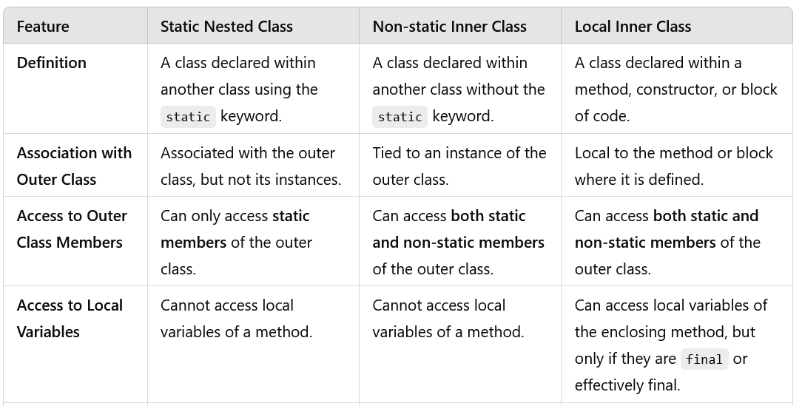

Slide 60
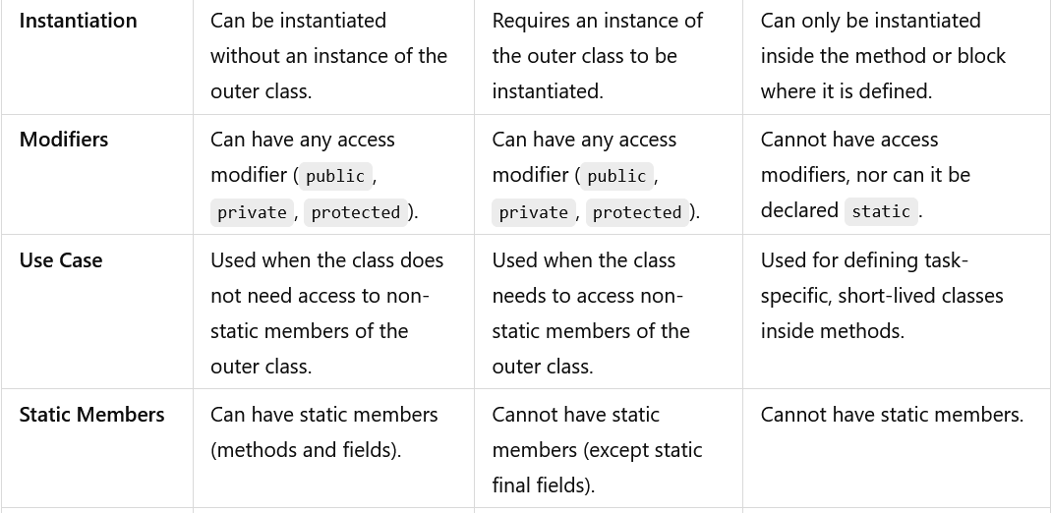

Slide 61
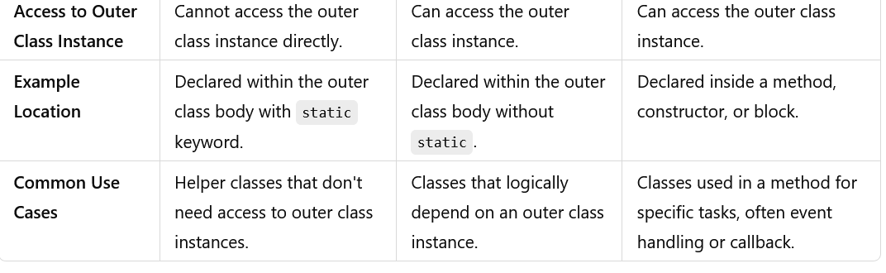

Slide 62
Object Class in Java
In Java, the Object class is the root class from which every class in Java directly or indirectly inherits.
It is the superclass of all classes and is part of the java.lang package, which means it is implicitly available to all classes without needing to be imported.
Since every class in Java is a subclass of Object, it provides several important methods that are either directly inherited or overridden by Java classes.
The Object class defines the default behaviour for essential operations, such as comparing objects, converting objects to strings, and managing memory.

Slide 63
Key Characteristics of the Object Class
Universal Superclass: Every class in Java automatically inherits from Object unless it explicitly extends another class. This means that all Java objects have access to the methods defined in Object.
Basic Methods: Object provides methods such as toString(), equals(), hashCode(), clone(), and others, which are fundamental to how objects behave in Java.

Slide 64
Important Methods of the Object Class
1. toString():
Returns a string representation of the object. By default, it returns the class name followed by the "@" symbol and the object's hash code in hexadecimal format.
Example: java.lang.Object@1b6d3586.
Commonly overridden to provide meaningful information about the object's state.
public String toString();

Slide 65
Continues………………
2. equals(Object obj):
Compares the current object with another object for equality.
The default implementation checks for reference equality, but this method is often overridden to check for content equality.
public boolean equals(Object obj);
3. hashCode()
Returns an integer hash code that is used for hash-based collections (e.g., HashMap, HashSet).
If equals() is overridden, hashCode() should also be overridden to ensure consistency.
public int hashCode();

Slide 66
Continues………………
4. getClass()
Returns the runtime Class object of the current instance.
This is useful for obtaining metadata about the object's class.
public final Class<?> getClass();
5. clone()
Creates and returns a copy of the object. It is a protected method, and the class must implement the Cloneable interface to use it.
If not implemented correctly, calling this method will throw CloneNotSupportedException.
protected Object clone() throws CloneNotSupportedException;

Slide 67
Continues………………
6. finalize() (Deprecated)
Used by the garbage collector to perform cleanup before destroying the object.
This method has been deprecated in Java 9 and replaced with better resource management techniques like try-with-resources.
protected void finalize() throws Throwable;

Slide 68
Continues………………
7. wait(), notify(), notifyAll()
These methods are used for thread synchronization.
They allow one thread to wait until another thread signals it to continue execution.
wait() makes the current thread wait until another thread calls notify() or notifyAll().
notify() wakes up one waiting thread, while notifyAll() wakes up all waiting threads.
public final void wait() throws InterruptedException;
public final void notify();
public final void notifyAll();

Slide 69
Example of the Object class in use:
class Example {
public static void main(String[] args) {
Object obj = new Object();
System.out.println(obj.toString()); // Calls toString() method
System.out.println(obj.hashCode()); // Calls hashCode() method
}
}
Because Object is the superclass of all classes in Java, these methods can be overridden in your own classes to define how objects should behave in specific cases.

Slide 70
String form of an object via tostring() method
In Java, the toString() method is used to obtain the string representation of an object.
By default, the toString() method in the Object class returns a string that consists of the class name followed by the "@" symbol and the hash code of the object in hexadecimal format.
However, this default string form is often not useful, so it's common to override the toString() method in custom classes to provide a more meaningful description of the object.

Slide 71
Default toString() Method
If you don't override the toString() method in your class, the default implementation from the Object class will be used. It looks something like this:
public String toString() {
return getClass().getName() + "@" + Integer.toHexString(hashCode());
}
Output
ClassName@HashCodeInHex

Slide 72
Example: Default toString() Method
class Example {
public static void main(String[] args) {
Object obj = new Object();
System.out.println(obj.toString());
// Outputs: java.lang.Object@1b6d3586
}
}
In the above example, java.lang.Object is the class name, and 1b6d3586 is the object's hash code in hexadecimal.

Slide 73
Object equality method
In Java, the equals(Object obj) method is used to determine if two objects are "equal."
It is defined in the Object class and can be overridden to provide content-based equality for custom classes.
By default, the equals() method in the Object class checks for reference equality—whether two object references point to the exact same object in memory.

Slide 74
Default Behavior of equals() Method (Reference Equality):
By default, the equals() method from the Object class behaves like this:
public boolean equals(Object obj) {
return this == obj; // Reference equality
}
This means the default implementation only returns true if both references point to the same object in memory.
In most cases, especially for custom objects, this behavior is not desirable.
Instead, you'll want to compare the content of the objects (such as field values), which requires overriding the equals() method.

Slide 75
End of Part 5

